Slide 1
THE PROFESSIONAL THE KOTHELAWELA DEFENCE UNIVERSITY 25th January 2024
PROFESSIONAL ETHICS - CE 3142

Slide 2
TOPICS
The Professional
Professions as social practices
Engineering and Professionalism
Models of Professionalism
Professional Ethics
Preventive Ethics
Aspirational Ethics
Deontological Ethics

Slide 3
THE PROFESSIONAL
The Professional – has the ability to command considerable power in the market place
As against the person with an occupation or doing a job
This is because the Professional;
1.0 - Has Extensive Training
- of an academic / intellectual character over and above practical skills
- have a minimum of an undergraduate degree
2.0 – Has Vital Knowledge and Skills
- specialization e.g. doctors, lawyers, accountants, engineers, etc

Slide 4
THE PROFESSIONAL
3.0 – has Control of Services
Professions have a monopoly
- they can exert considerable control over professionals services
a. Qualified – practitioners must meet educational and experience standards as required by the profession
b. Licensing - practitioners as qualified above, get State recognition, earning the confidence of the community
Sri Lanka Medical Council GMOA ???
Engineering Council of Sri Lanka
Bar Association of Sri Lanka

Slide 5
THE PROFESSIONAL
4.0 – has Autonomy in the Workplace
- exercise greater degree of individual judgement in carrying out duties
- mainly in private practice; to a lesser degree in organisations
Justification – only the professional has sufficient knowledge to determine the appropriate professional service for a given situation
Autonomy – promote economic self-interest
- doctor prescribing more test than necessary
Autonomy – independence or freedom, as of the will or one’s actions

Slide 6
THE PROFESSIONAL
5.0 – makes Claim to Ethical Regulation
- claim to be regulated by ethical standards as given in a Code of Ethics
- many professions limit themselves to the public benefit
- violations – limited action
→ expel from organization or cancelling license to practice
Professions have one or both of the following dimensions:
- Altruism – selfless concern for the well—being of others
- Self-interest – need or desires of one’s self

Slide 7
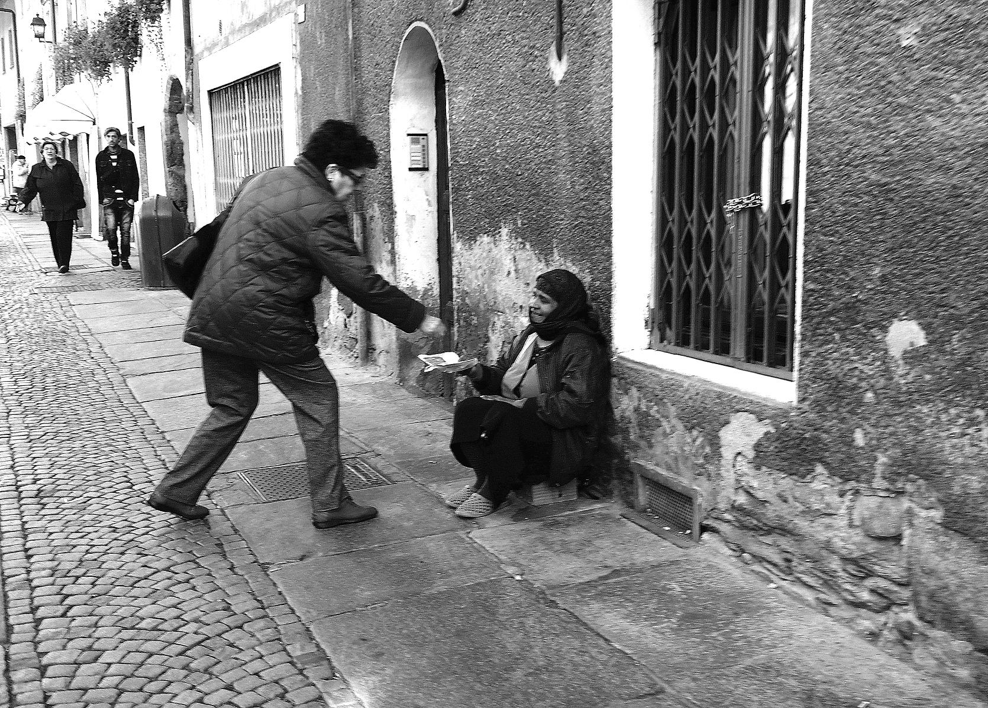

SELF-INTEREST
one's personal interest or advantage, especially when pursued without regard for others.
ALTRUISM
the belief in or practice of disinterested and selfless concern for the well-being of others.

Slide 8
PROFESSIONS AS SOCIAL PRACTICES
A profession is an example of a “social practice”
1. Every social practice has one or more aims or benefits that are specially associated with it
e.g. medicine aims at the health of patients: the aim of law is justice
A practice may also produce other benefits, such as money, social prestige, etc
2. A social practice is inconceivable without this “aim”
3. The aim of a social practice must be morally justifiable aims
4. The distinctive aim of a social practice provides a criterion for evaluating the behaviour of practitioners and for resolving moral issues that arise in the practice.
The advantage of this concept of professionalism is that it has a moral orientation, and characterizes the professions as institutions that must not only be morally permissible, but also aim at some moral good

Slide 9
ENGINEERING AND PROFESSIONALISM
IS ENGINEERING A TRUE PROFESSION ???
Engineers have extensive training
Engineers have the knowledge and skills that are vital to the public
Engineers have the right to practice at a responsible level once they become professionally qualified, i.e. Chartered or Professional Engineers
With Engineering Council Sri Lanka the practice becomes more controlled
Engineers are expected to comply with the Code of Ethics of the Institution of Engineers, Sri Lanka
Engineers may not have a great degree of autonomy when working in State or Private sector organizations

Slide 10
ENGINEERING AND PROFESSIONALISM
Engineering is a group activity, which requires special knowledge, skill and judgement
It is an occupation by which engineers earn their living, and it is entered into voluntarily
Engineering serves a morally good end, namely the production of technology for the benefit of mankind, and there is no reason why morally permissible means to that end cannot be used.
Engineers have a special obligation to society, which is the protection of the health, safety and welfare of the public, as this may be affected by technology
HENCE ENGINEERS HAVE FULL PROFESSIONAL STATUS !!!

Slide 11
MODELS OF PROFESSIONALISM
The importance of ethical concepts in professionalism can be also shown through the two models of the Professional
The Business Model
The Professional Model

Slide 12
MODELS OF PROFESSIONALISM
BUSINESS MODEL
Here the primary motive is to make profits within the boundaries of the law
A profession, like any other business, sells a service / product for profit, constrained by legal requirements
Advantage is taken in that they have expertise needed by the ordinary citizen
They would profess self-regulation to avoid close governmental supervision
The difference between the professional adopting the “Business Model” and other occupations such as sales or manufacturing, is that the latter sell a tangible product, while the professional seek profit by selling their expertise

Slide 13
MODELS OF PROFESSIONALISM
PROFESSIONAL MODEL
The critical concept here is that professionals are trusted by the public
Professionals agree to regulate their practice to promote public good
As in Engineering Codes of Ethics, “To hold paramount the safety, health and welfare of the public”
That is they agree to work in accordance with high standards of technical competence and ethical practice, so as not to take unfair advantage of the public
Professionals may seek control over the provision of services, in order to protect the public from incompetent practitioners
.

Slide 14
MODELS OF PROFESSIONALISM
PROFESSIONL MODEL
In return professionals are accorded high social standing, better income and considerable autonomy
The public also pay for a large component of professional education
In reality most professionals are not so idealistic that they consider total dedication to the public cause. Neither are they so callous and self-interested that they think wholly in terms of profit
Nevertheless the notion of professionalism, requires that a professional adopts the “Professional Model”, where ethical commitment is paramount
Hence the Ethical component is of central importance in engineering professionalism

Slide 15
PROFESSIONAL ETHICS
PROFESSIONAL ETHICS is the set of standards adopted by professionals in conducting themselves as professionals
They have several important characteristics
Professional ethics is usually stated in a formal code – Code of Ethics
Professional Codes of ethics focus on issues that are important to the profession
In a professional relationship, professional ethics takes precedence over personal morality or interest
Professional ethics can on some occasions differ from personal morality in its degree of restriction of personal conduct
Professional ethics has a negative and positive dimension

Slide 16
PROFESSIONAL ETHICS
Role Morality – is the moral obligation based on specific roles and relationships
Special obligation of parents to children
Obligation of political leaders to look after the well being of citizens
Professional Ethics is another example of Role Morality, as professionals have an obligation not to harm their clients, employers, or the public; and also an obligation to look after their well-being
The negative aspect of professional ethics focuses on the prevention of malpractices and harm to the public. This is Preventive Ethics
Professionals also have an obligation to use their knowledge and expertise to promote public welfare. This positive aspect of professional ethics is known as Aspirational Ethics

Slide 17
PREVENTIVE ETHICS
Preventive Ethics is commonly set out in the clauses of a Code of Ethics
They may be explicitly negative, having words like “not”, “only”, etc
“…….build reputation on merit and not compete unfairly”
“……..perform professional services only in areas of their competence”
Many clauses that are not stated in the negative form, nevertheless have an essentially negative implication
“……..shall act in a manner to uphold the honour of the profession”
“……..give evidence, express opinions in a objective and truthful manner”
Reasons for negative connotation:
Duty not to harm other
Easier to enforce
Disaster cases – cases which resulted in harm or even loss of life

Slide 18
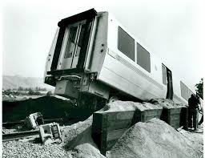
PREVENTIVE ETHICS
Disaster Cases :
Bay Area Rapid Transit (BART) case:
BART went into service in 1972. Three engineers identified major shortcoming in the installation and testing, and communicated these concerns to management, both orally and in writing; they were told not to make trouble. The three engineers presented their concerns confidentially to a member of the BART board of directors, and they were fired. Three weeks after BART began carrying passengers, one of the BART trains crashed at the Fremont station due to a short circuit in a transistor. Fortunately, there were no deaths and only a few injuries. The three engineers finally won out-of-court settlements, although their careers were disrupted for almost 2 years. The case generated legal precedents that have been used in subsequent cases, and it had a major impact on the development of engineering ethics.
DC-10
Challenger Space Shuttle

Slide 19
ASPIRATIONAL ETHICS
The Negative aspect of Professional Ethics is easier to enforce, as it tells the professional what he/she should not do to cause distress to the public
There is an absence of a motivational dimension
Why does a person choose Engineering as a career ??
Reason A | Reason B
Good financial package | To improve the quality of human life
Enhanced social standing | To save the environment

Slide 20
ASPIRATIONAL ETHICS
Aspirational ethics involves a spectrum of engineering activities.
Let us call the more extreme and altruistic examples of aspirational ethics ‘‘good works’’ and the more ordinary and mundane examples ‘‘ordinary positive engineering.’’
“Good Works” refers to the more outstanding and altruistic examples of aspirational ethics—those that often involve an element of self-sacrifice. Good works are exemplary actions that may go beyond what is professionally required
“Ordinary Positive Engineering”: Most examples of aspirational ethics do not readily fall into the category of “good works”. They are done in the course of one’s job, and they do not involve any heroism or self-sacrifice.
Most of the things an engineer does are examples of “ordinary positive engineering”, as long as a it can be shown that they contribute in some way to human welfare.

Slide 21
ASPIRATIONAL ETHICS
Good Works !!
Engineers Without Borders - is an international organization for engineering professionals and engineering students who want to use their professional expertise to promote human welfare.
Engineering students from the University of Arizona did a water supply and purification project in Ghana, where 30 villages, with approximately 10,000 people, will get safe drinking water.
Similarly, engineering students from the University of Colorado installed a water system in a Rwandan village, where the system provides villagers with up to 7000 liters of safe water for everyday use.
Air Bags - Carl Clark helped to develop air bags. Even though he was a scientist and not a degreed engineer, his work might well have been done by an engineer. He has even invented wearable air bags for the elderly to prevent broken hips. He did not get paid for all of his time.

Slide 22
ASPIRATIONAL ETHICS
Ordinary Positive Engineering
These are done in the course of one’s job, and they do not involve any heroism or self-sacrifice.
Most of the things an engineer does are examples of ordinary positive engineering, as long as a good argument can be made that they contribute in some way to human welfare.
An access road in a rural area to enable farm produce to be brought to town
Extending the power supply to give electricity to rural areas without electricity
Installing sewerage / waste water treatment plants for towns without this facility
Over and above this there may be actions that usually involve a more conscious and creative attempt to do something that contributes to human welfare.
Disaster recovery after the 2004 Tsunami

Slide 23
ASPIRATIONAL ETHICS & PROFESSIONAL CHARACTER : THE GOOD ENGINEER
Aspirational engineering ethics has a motivational element that is not present in the same way in preventive ethics.
Aspirational ethics also has a discretionary element, which gives an engineer has a considerable degree of freedom in how he or she promotes public welfare
Neither of these two features can be conveyed well in Rules. Rules are not very effective motivational instruments, especially motivation to positive action.
The ‘‘good engineer’’ is the engineer who has those traits of professional character that make him or her the best or ideal engineer. To be sure, the vocabulary of professional character can also be used to describe the engineer who would be a good exponent of preventive ethics.

Slide 24
ASPIRATIONAL ETHICS & PROFESSIONAL CHARACTER : THE GOOD ENGINEER
The “Professional Character” could have the following traits;
Professional Pride – achieving and displaying all-round technical excellence
Social Awareness - an awareness of the way in which technology both affects and is affected by the larger social environment
Environmental Consciousness – awareness of the possible adverse impact engineering action could have on the natural environment

Slide 25
CHARACTERISTICS OF THE PROFESSIONAL
Characteristics of a highly reputable Engineer
Engineering Competence | Integrity
Imaginativeness | Civic mindedness
Perseverance | Honesty
Good Communication skills | Admit and Learn from mistakes
Team working | Environmental Commitment
Commitment to Quality | Self – sacrifice
Up-to date knowledge

Slide 26
GRADUATE ATTRIBUTES
GRADUATE ATTRIBUTES – WASHINGTON ACCORD
Engineering knowledge
Problem solving
Design / Development of solutions
Investigations
Modern Tool useage
Engineer and Society
Environment and Sustainability
Ethics
Individual and Team Work
Communications
Project Management and Finance
Life-long Learning

Slide 27
Deontological Ethics
In moral philosophy, Deontological ethics or Deontology is the normative ethical theory that the morality of an action should be based on whether that action itself is right or wrong under a series of rules, rather than based on the consequences of the action.
Deontology states that an act that is not good morally can lead to something good,
such as shooting the intruder (killing is wrong) to protect your family (protecting them is right). ... In our example, that means protecting your family is the rational thing to do—even if it is not the morally best thing to do.

Slide 28
Acknowledgement
Charles Harris, Michael Pritchard, Michael Rabins : Engineering Ethics – Concepts and Cases; Wadsworth Cengage Learning, 4th Edition
https://ethicsunwrapped.utexas.edu/glossary/deontology
https://media.washtimes.com/media/image/2016/10/06/106_2016_1084782898201.jpg
http://www.borgenmagazine.com/wpcontent/uploads/2016/09/Understanding-Effective-Altruism-Applying-Strategy-to-Charity.jpg

Slide 29


Slide 30

THANK YOU !!!!

